Slide 1

Tredence Data Scientist Hiring Challenge

Slide 2
Demand Forecasting
The company holds warehouses in various cities across the country. Different items are sent to these warehouses on a weekly basis and from where they are distributed to various small stores on a daily basis.
To increase the efficiency of this process, the management has decided to build software that can forecast weekly and daily demand in advance.

Slide 3
Task
A relevant dataset about the demand for products in the warehouses.
To build a machine learning model that can forecast weekly as well as daily demand.
Notes :
Model will be evaluated on the basis of predicted weekly_dispatch_count, However, also required to analyze and forecast the daily_dispatch_count for the test data.
Must create an ipython notebook containing your analysis and approach for the given task and upload it by clicking the Upload Source Code button.

Slide 4
Dataset description
The dataset folder contains the following files:
train.csv. 16644 x 12
test.csv: 4900 x 10
submission_weekly.csv: 700 x 2

Slide 5
The columns provided in the dataset are as follows:
Column name | Description
ID | Represents the unique identification of each entry
date | Represents the date in "yyyy-mm-dd" format
warehouse_ID | Represents the unique identification of a warehouse
Latitude | Represents the latitude of the warehouse
Longitude | Represents the longitude of the warehouse
Product Type | Represents the type of a product ( Type_A or Type_B)
year | Represents the current year
month | Represents the current month of the year
is_weekend | Represents whether the day is weekend or not
is_warehouse_closed | Represents whether the warehouse is closed or not
daily_dispatch_count | Represents the number of items of a specific product type that are dispatched (in thousands) from a specific warehouse on a specific day
weekly_dispatch_count | Represents the number of items of a specific product type that are dispatched (in thousands) from a specific warehouse in the corresponding week, Note: The weekly_dispatch_count is calculated on Sundays.

Slide 6
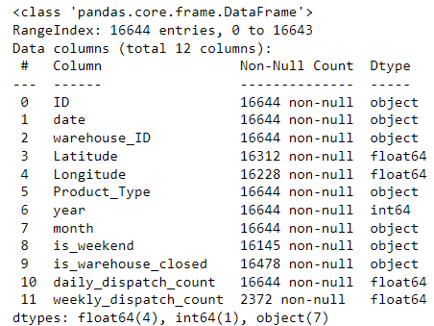
Train Dataset information

Slide 7
Fill null value in Latitude and Longitude
Warehouse_ID | Latitude | Longitude
WH_0x3e9 | 41.681471 | -72.794746
WH_0x3ea | 38.749077 | -105.183060
WH_0x3eb | 35.678970 | -109.067413
WH_0x3ec | 34.361664 | -86.305595
WH_0x3ed | 25.750156 | -80.279640
WH_0x3ee | 30.189375 | -82.648254
WH_0x3ef | 41.611603 | -87.551186
WH_0x3f1 | 48.692551 | -116.319862
WH_0x3f0 | 37.915825 | -89.829262
WH_0x3f2 | 61.600803 | -149.125259

Slide 8
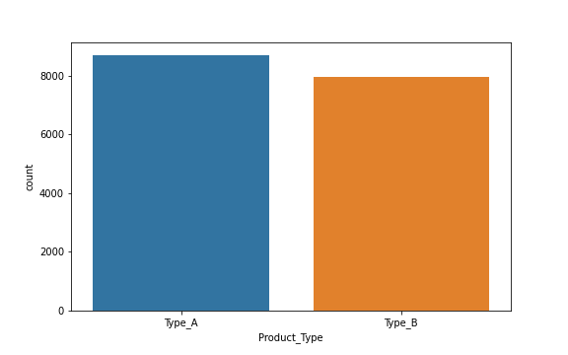
How may product id is present in dataset...

Slide 9
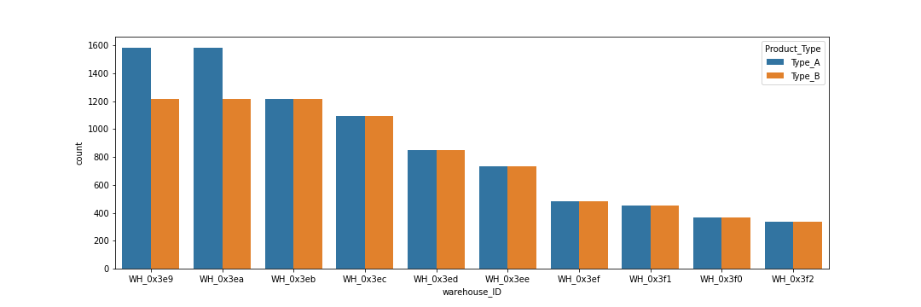
How may product id is present in dataset...

Slide 10
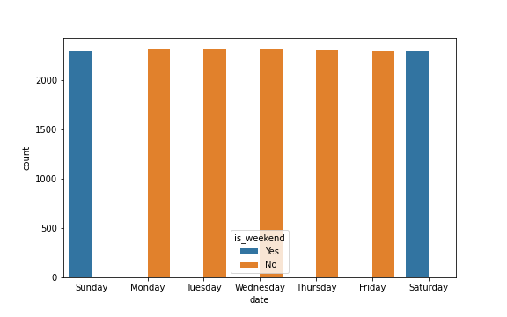
Which day is weekend
As per this graph clearly shows that Sunday and Saturday are weekend and rest of day is not weekend...
And fill null value according to this bar-chart.

Slide 11
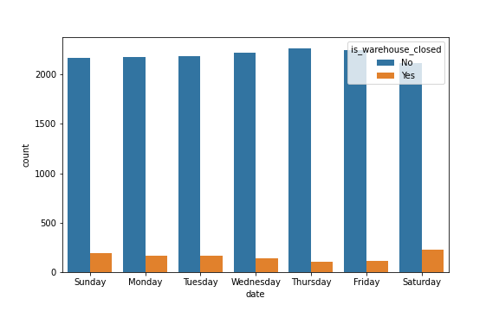
is warehouse closed related with week-days ...
According to, this graph is not related to week-days...

Slide 12
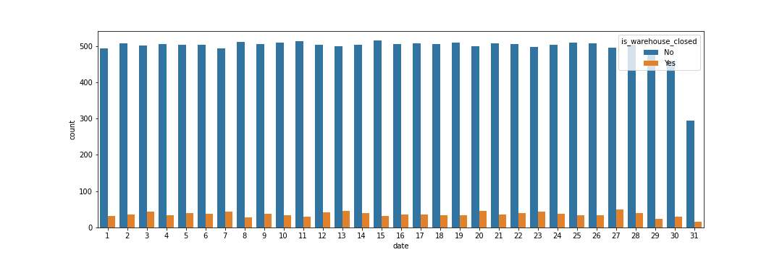
is warehouse closed related with date...
According to, this graph is not related to date...

Slide 13
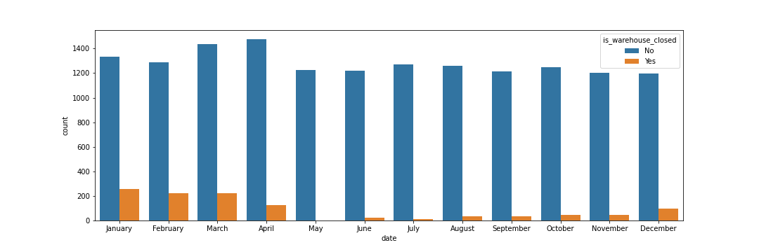
is warehouse closed related with month...
According to, this plot is some king of pattern is show-up like May to December is gradually increased, while January to April gradually declined, lastly in the May month warehouse is normally opened, never be closed, while, in a month of a January has maximum day id closed., But it not helpful fill null value.

Slide 14
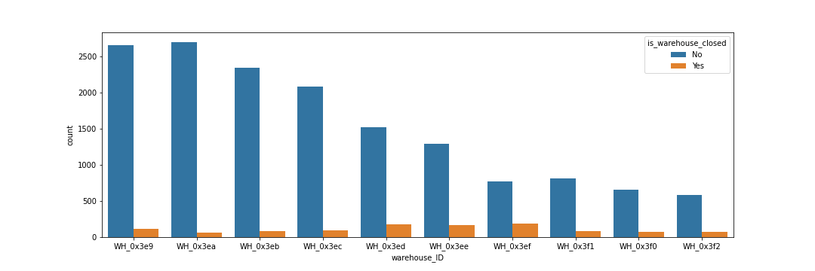
is warehouse closed related with warehouse Id or their location...
According to, this graph is not related to warehouse Id...

Slide 15
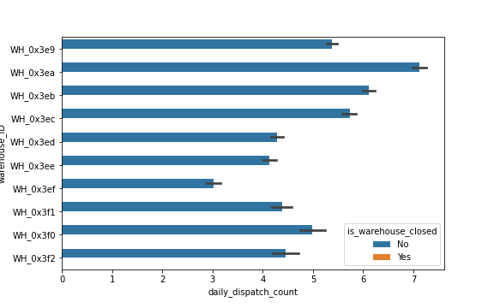
is warehouse closed related with our target column, because in the train dataset we have daily_dispatch_count has not null value...
Now, this picture is clear whenever column daily_dispatch_count value is 0 that means warehouse is closed.
So, we fill null value in train dataset by using column daily_dispatch_count...

Slide 16
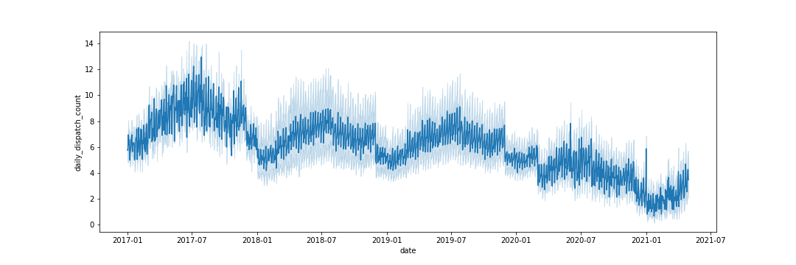
Now, plot line graph for this columns according to date...
It is difficult for understanding...

Slide 17
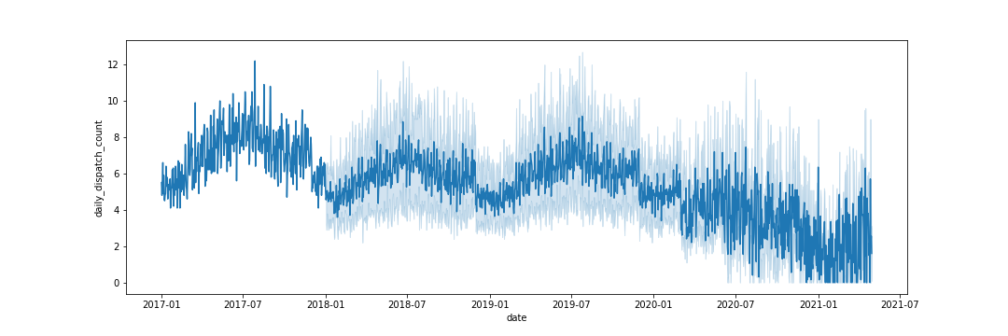
Now, plot line graph for this columns according to date for only one warehouse...
It was also not helping...

Slide 18
Data Preparation…
First convert all category data and object data into numeric format. Because of while run model of find pattern between features and target columns that time string data not valid. So, do this using LabelEncoder.
Also extract Date in to Date, Month, Year, Weekdays, Weeks, Quarter.

Slide 19
ID | day | warehouse_ID | week | weekday | Product_Type | quarter | month | is_weekend | is_warehouse_closed | Latitude | Longitude | year | daily_dispatch_count | weekly_dispatch_count
0 | 1 | 0 | 52 | 6 | 0 | 1 | 4 | 1 | 0 | 41.681471 | -72.794746 | 2017 | 5.5 | 5.5
2796 | 1 | 1 | 52 | 6 | 0 | 1 | 4 | 1 | 0 | 38.749077 | -105.183060 | 2017 | 6.1 | 6.1
1 | 2 | 0 | 1 | 0 | 0 | 1 | 4 | 0 | 0 | 41.681471 | -72.794746 | 2017 | 4.8 | NaN
2797 | 2 | 1 | 1 | 0 | 0 | 1 | 4 | 0 | 0 | 38.749077 | -105.183060 | 2017 | 6.7 | NaN
2 | 3 | 0 | 1 | 1 | 0 | 1 | 4 | 0 | 0 | 41.681471 | -72.794746 | 2017 | 5.8 | NaN

Slide 20
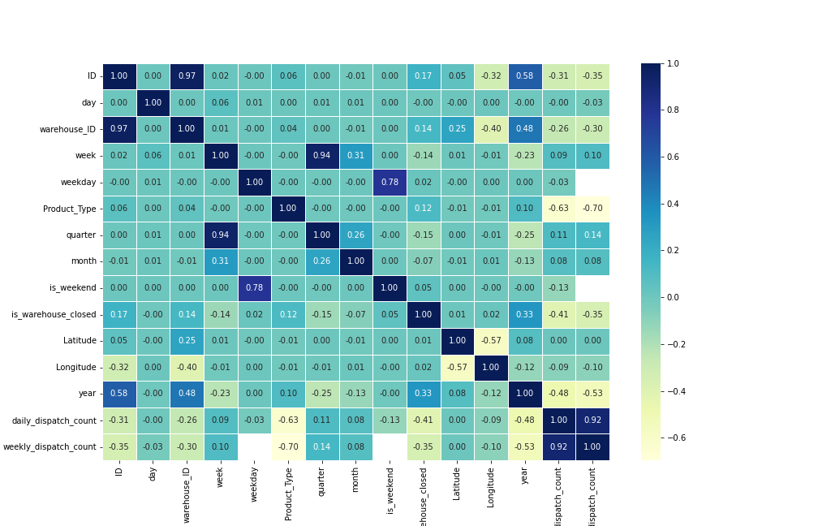
Plot correlation matrix...

Slide 21
Split data into features and target columns
Split columns into features(x) and target(y) columns...
In this dataframe first predict daily_dispatch_count and then after weekly_dispatch_count, as well as we drop ID column from features column because of this is only unique identification of reported data...
After that, split all data into two part Training data and Testing data by using train_test_split.
Split training set and testing set by 90:10 ratio...

Slide 22
Model running
On this data-frame we run Regression model, because our target column is continuous dependent variable from a number of independent(feature) variables.
There are three model running
LinearRegressor
RandomForestRegressor
GradientBoostingRegerssor
And check its score(accuracy) value...

Slide 23
Model Score
'LinearRegression': 0.6926662622091592
'RandomForestRegressor': 0.8476727881918164
'GradientBoostingRegressor': 0.8492725588865788
As per result GradientBoostingRegressor's performance it is much better then other model.
So, we run GradientBoostingRegressor model separately...

Slide 24
Hyper tunning model by using RandomizedSearchCV...
RandomizedSearchCV(cv=2, estimator=GradientBoostingRegressor(), n_jobs=1,
param_distributions={'learning_rate': [0.001, 0.01, 0.1],
'max_depth': [1, 2, 4],
'n_estimators': [500, 1000, 2000],
'random_state': [1],
'subsample': [0.5, 0.75, 1]},
scoring='neg_mean_squared_error')

Slide 25
Check Best parameters of this model & set this parameters of this model check their performance...
GradientBoostingRegressor(subsample = .5,
random_state = 1,
n_estimators = 2000,
max_depth = 4,
learning_rate = 0.01)
Score = 86.2251152177329 %
Now, model is ready to predict for test dataset..

Slide 26
Make Prediction…
First, make test data according feature value by filling all nun value, also convert all data into numeric format and last make sure all data same as test input data...
After that make prediction daily_dispatch_count on according to test data.
After that caluculate weekly_dispatch_count by using daily_dispatch_count (predicted data).

